Slide 1

Master‘s Thesis in Computer Science
—
Dynamic Surface Reconstruction from Multi-View Videos using Gaussian Splatting
Brianne Oberson
—
Technische Universität Berlin
Examiners: Priv.-Doz. Dr.-Ing. Oliver Schreer, Prof. Dr.-Ing. Olaf Hellwich
Supervisor: Decai Chen

Slide 2
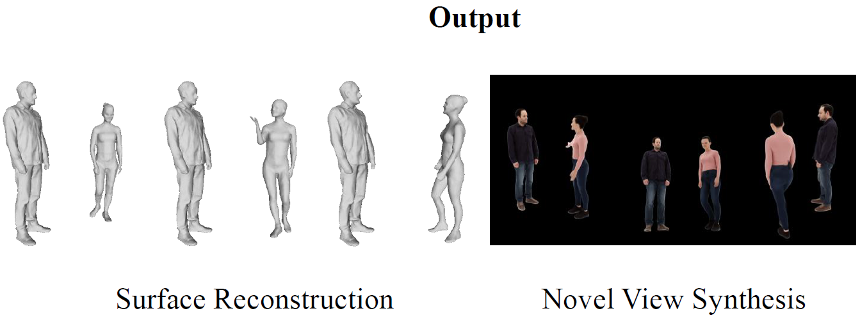
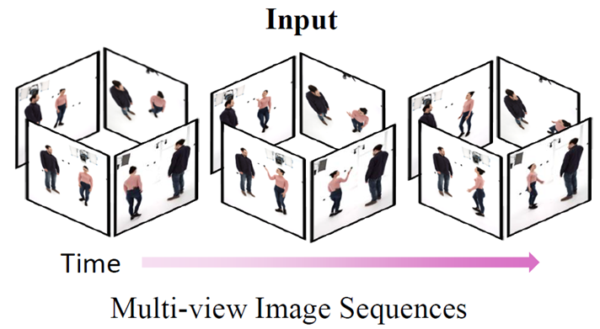
Introduction
Dynamic Reconstruction: What Is It?
Output
Input
Notes:
- As input: Set of image sequences / or videos from multiple camera view points
- goal is to recover high-fidelity surface geometry and appearance.

Slide 3




Motivation
Dynamic Reconstruction: Why It Matters
Applications:
VR/AR: Immersive experiences
Game Development: Lifelike character animation
Film Industry: Digital doubles & VFX
Cultural Heritage: Eva Umlauf / Ernst Grube
All these applications are developed using modern graphics engines, which require
explicit mesh geometry for physics simulations, geometry editing and texture mapping.
Icons by Dmytro Vyshnevskyi, Good Ware, FreshForYou and Flat Icons Design from Flaticon.com
Notes:
VR/AR: the rise in popularity of VR and AR experiences
requires realistic digital representations that users can interact with in immersive environments.
Game development
studios need to create lifelike characters that move and behave naturally
Film industry:
relies on high-quality digital doubles for visual effects
actors' performances and movements need to be captured and reconstructed with incredible fidelity.
cultural heritage preservation - like the Eva Umlauf project you can see displayed in our hallway
it's crucial that when someone is giving their testimony, their digital representation feels authentic and realistic.
The emotional impact of these important historical stories depends on that sense of genuine human connection.
All of these applications require accurate geometric representation of dynamic scenes.

Slide 4


Related Works
Current Landscape and Research Gap
Neural Radiance Fields:
Dynamic mesh reconstruction
Slow training
Limited reconstruction quality
3D Gaussian Splatting:
High visual quality
Fast training
No dynamic surface reconstruction
 | View-Synthesis | Surface Reconstruction
Static
Dynamic
Can we fill this gap while maintaining 3DGS efficiency
AND achieving better reconstruction quality than NeRF based methods?
Notes:
Until recently, Nerf was SOTA for dynamic surface reconstuction
original NeRF method was extended to dynamic and mesh reconstruction
But with relatively slow training
And limited reconsruction quality
3DGS came out
Extremly high rendering quality
Very fast training
But not adapted to dynamic surface reconstruction
This the GAP that this thesis adresses
The question is….

Slide 5


Related Works
Capabilities and limitations
 | 4K4D | 4DGS / STG | NeuS2 | Proposed Method
Photo-realistic Rendering
Fast Training
High Quality Surface
Notes:
Overview of the related works.
NeuS2: is the Nerf based SOTA, only one that ticks all the boxes -> orange: not as good
4K4D: Point cloud with 4D feature grids + hybrid appearance model (MLP + image blending)

Slide 6
Proposed Method
Spacetime Surfels
Static
Surface Reconstruction
Dynamic
View-Synthesis
Gaussian Surfels
Spacetime Gaussians
Spacetime Surfels
Dynamic
Surface Reconstruction
Notes:
Leverage what already exists:
Static surface reconstruction suing GS was already tackled -> Gsurf does this really well, getting high quality surface meshes
Dynamic rendering using GS was also already tackled -> STG does this really well
Both methods showed good results and were getting a lot of attention from the research community
-> combine the key components into one unified method “Spacetime Surfels”

Slide 7
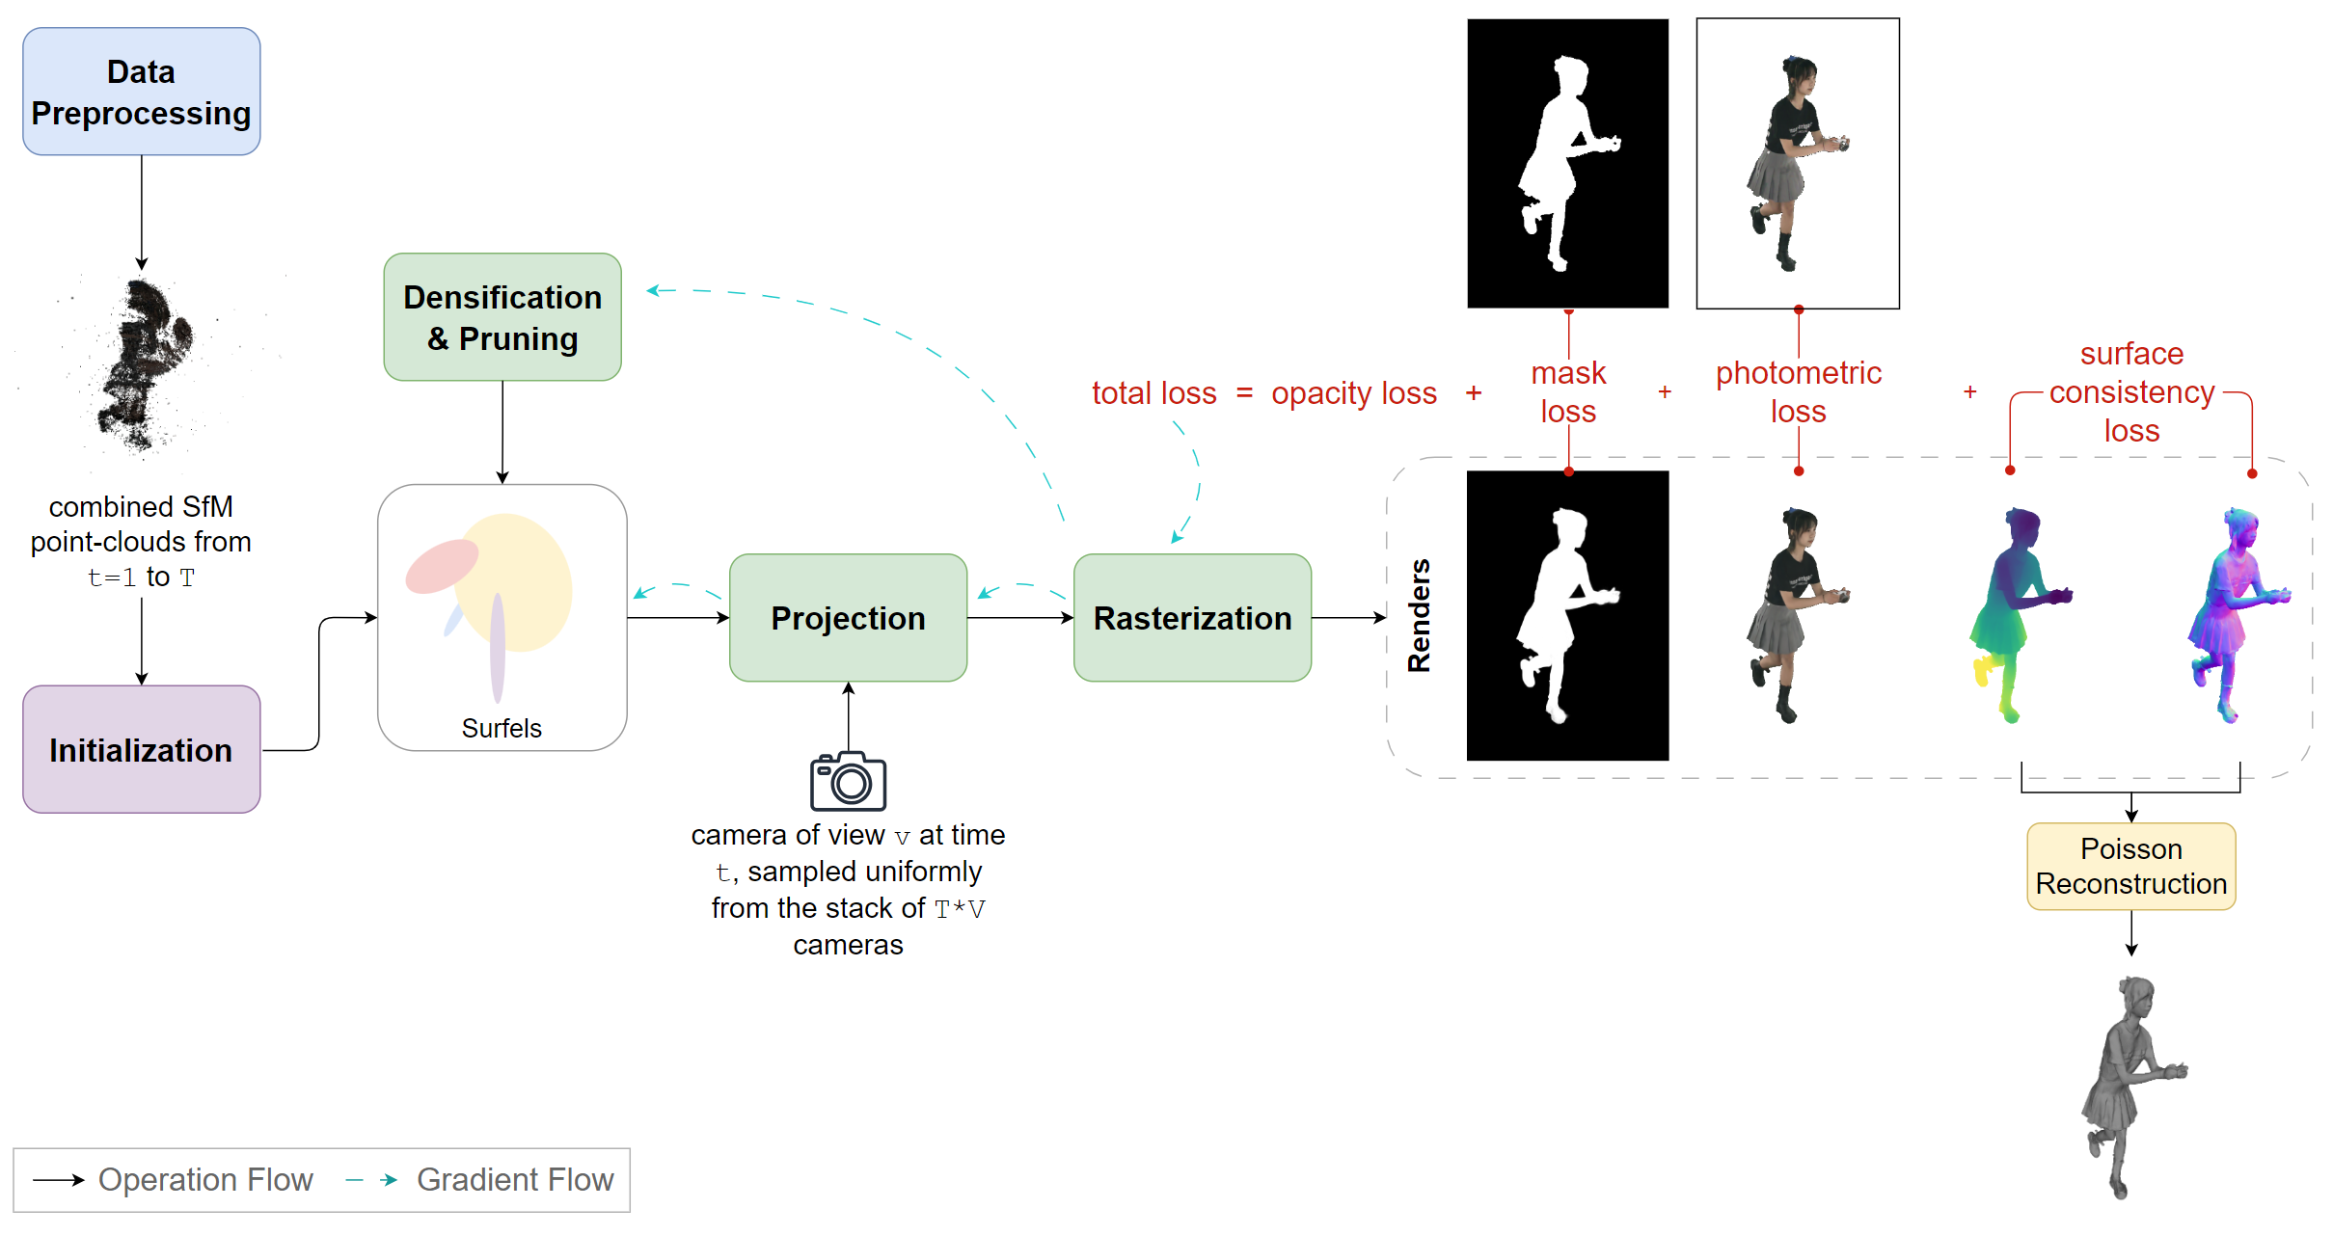
Spacetime Surfels
Pipeline Architecture
Notes:
Let me walk you through how Spacetime Surfels works, step by step.
We start with data preprocessing - taking multi-view videos and extracting point clouds using Structure from Motion for each time frame
These points clouds are combined into one point cloud which we use as initialization for our gaussian. Each gaussian has properties which I will present in the next slide.
We then take a camera viewpoint at a specific time, sampled from our stack of cameras. The gaussian get projected onto the camera’s image plane, then rasterized to generate different outputs.
Our training uses a composite loss function with four key components:
This feeds back through gradient flow - shown by the blue dashed arrows - to update our gaussian parameters. We also have densification and pruning to adaptively add or remove gaussian based on scene complexity.
Finally, once optimization is complete, we use Poisson reconstruction to convert our optimized gaussian into clean 3D meshes for each time frame.
Initialization:
with its spatial coordinates, RGB values and timestep directly mapped to the Gaussian’s initial position, color parameters and tRBF center respectively.

Slide 8
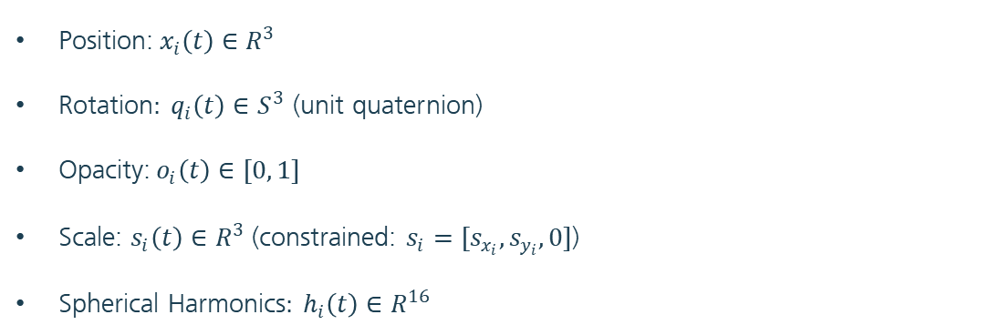
Spacetime Surfels
Properties
A Spacetime Surfel $i$ is characterized by the following:
Position:$x_{i}\left(t\right)∈R^{3}$
Rotation$: q_{i}\left(t\right)∈S^{3}$ (unit quaternion)
Opacity:$o_{i}\left(t\right)∈[0, 1]$
Scale: $s_{i}\left(t\right)∈R^{3}$ (constrained: $s_{i}=[s_{x_{i}}, s_{y_{i}}, 0]$)
Spherical Harmonics$: h_{i}\left(t\right)∈R^{16}$
Notes:
- Brief explanation that these extend standard 3D Gaussians with temporal components
- Emphasize the flat surfel representation (third scale axis = 0)

Slide 9

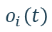
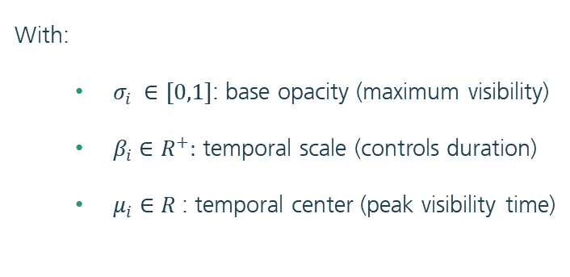
Spacetime Surfels
Temporal Opacity Model
Opacity is modeled using a temporal radial basis function:
$$o_{i}\left(t\right)= σ_{i} exp(−β_{i} \left|t−μ_{i}\right|)$$
With:
$σ_{i} ∈[0,1]$: base opacity (maximum visibility)
$β_{i}∈R^{+}:$ temporal scale (controls duration)
$μ_{i}∈R$: temporal center (peak visibility time)
$$o_{i}\left(t\right)$$
$$t$$
Notes:
σi ∈ [0, 1] represents the base opacity, controlling the maximum visibility of the surfel
• βi ∈ R+ defines the temporal scale parameter, inversely related to the surfel’s temporal duration - smaller values result in longer visibility periods
• µi ∈ R specifies the temporal center, marking the time at which the surfel reaches its peak visibility σi

Slide 10
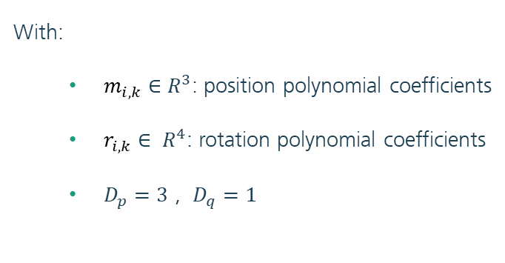
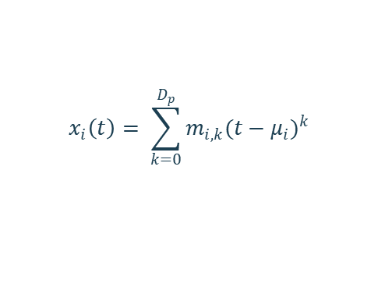
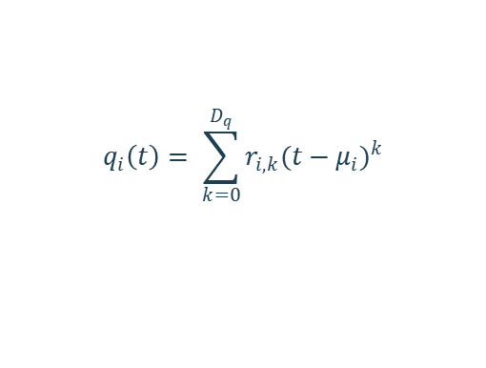
Spacetime Surfels
Polynomial Motion and Rotation
The position and rotation of the surfel is modeled through a polynomial function centered at each surfel‘s temporal peak $μ_{i}$ :
$$x_{i}\left(t\right)= \sum_{k=0}^{D_{p}}{m_{i,k}{(t−μ_{i})}^{k}}$$
$$q_{i}\left(t\right)= \sum_{k=0}^{D_{q}}{r_{i,k}{(t−μ_{i})}^{k}}$$
With:
$m_{i,k}$ $∈$ $R^{3}$: position polynomial coefficients
$r_{i,k}$ $∈ R^{4}$: rotation polynomial coefficients
$D_{p}=3$ , $D_{q}=1$
Notes:
adopting polynomial degrees of Dp = 3 for position and Dq = 1 for rotation. This choice was motivated by STG’s analysis showing that cubic polynomials for position provide the optimal balance between motion complexity and computational cost, while linear interpolation sufficiently captures rotational dynamics.

Slide 11
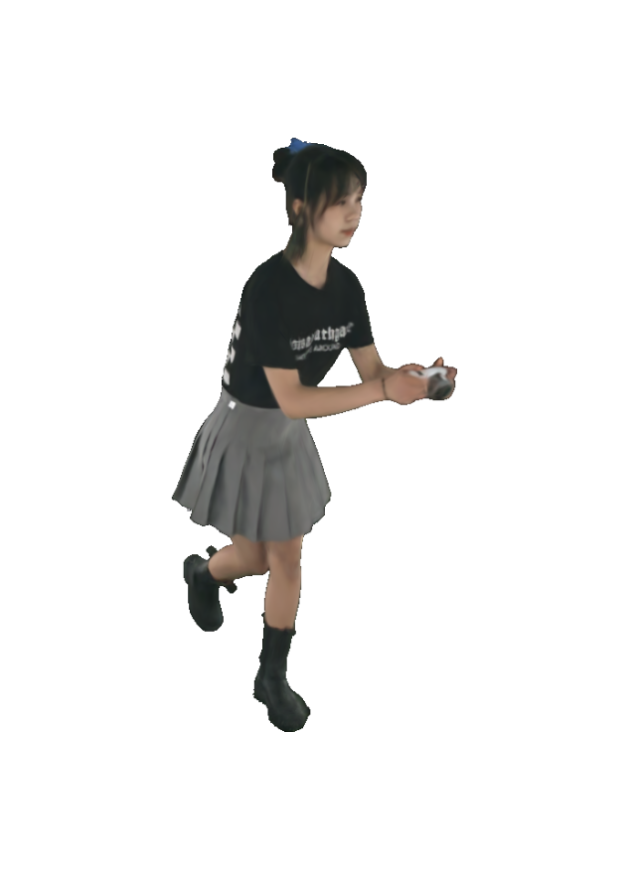
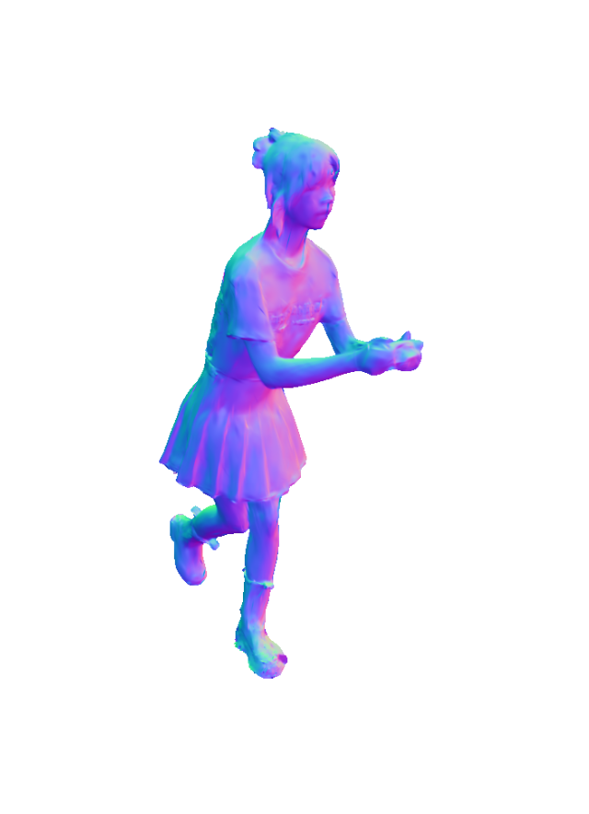

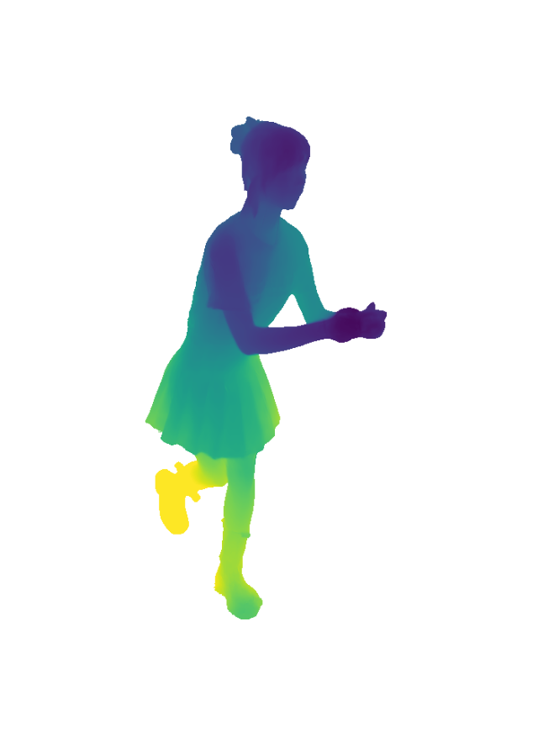
Spacetime Surfels
Rendering
All four rendering types use the same core alpha-blending process from the original paper 3DGS
RGB Rendering:
Alpha-blend colors by casting rays through pixels and intersecting surfels front-to-back
Normal Rendering:
Alpha-blend normal vectors extracted from the rotation matrix
Opacity Rendering:
Accumulate alpha values of each surfel along the ray
Depth Rendering:
Alpha-blend depth values computed from ray-surfel intersections
Notes:
Todo: make sure i am able to explain the how to get the normals and the depths

Slide 12

Spacetime Surfels
Optimization
We optimize the surfel parameters by minimizing the loss function $ℒ$:
$ℒ=ℒ_{p}+{λ_{o}ℒ}_{o}$ + $λ_{m}ℒ_{m}$ + $λ_{s}ℒ_{s}$
Notes:
Todo: make sure i am able to explain the how to get the normals and the depths

Slide 13
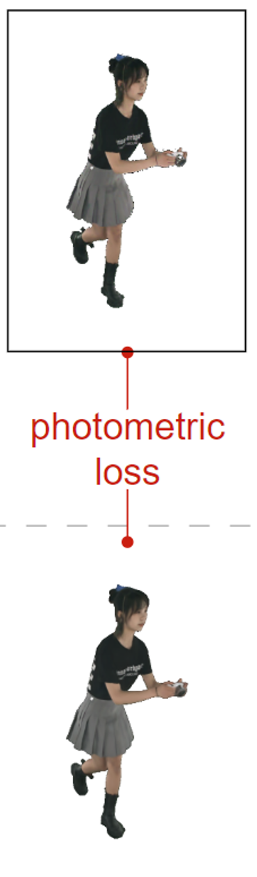

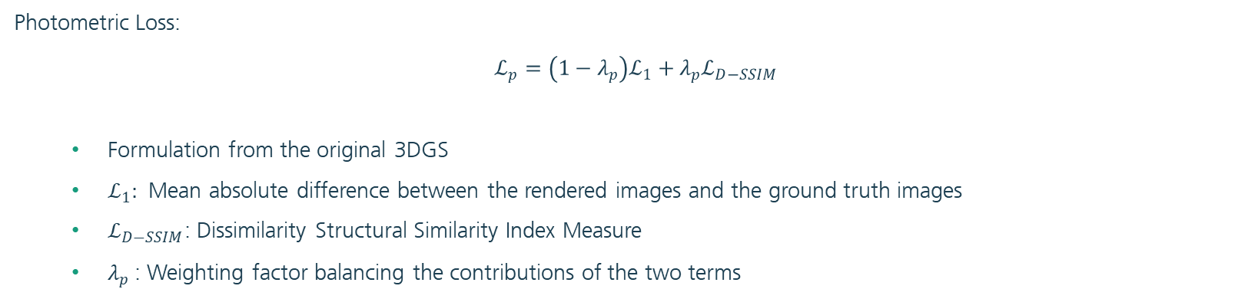
Spacetime Surfels
Optimization
We optimize the surfel parameters by minimizing the loss function $ℒ$:
$ℒ=ℒ_{p}+{λ_{o}ℒ}_{o}$ + $λ_{m}ℒ_{m}$ + $λ_{s}ℒ_{s}$
Photometric Loss:
$$ℒ_{p}=\left(1−λ_{p}\right)ℒ_{1}+λ_{p}ℒ_{D−SSIM}$$
Formulation from the original 3DGS
$ℒ_{1}:$ Mean absolute difference between the rendered images and the ground truth images
$ℒ_{D−SSIM}$: Dissimilarity Structural Similarity Index Measure
$λ_{p}$: Weighting factor balancing the contributions of the two terms
Notes:
Todo: make sure i am able to explain the how to get the normals and the depths

Slide 14
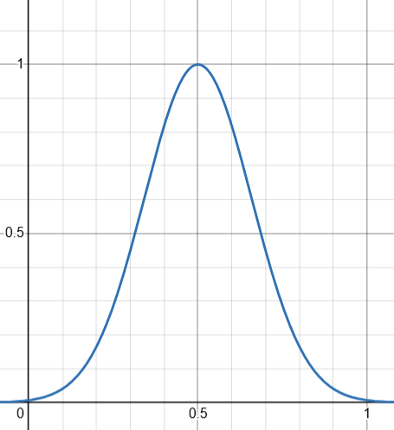
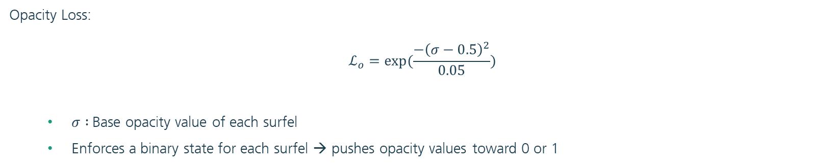
Spacetime Surfels
Optimization
We optimize the surfel parameters by minimizing the loss function $ℒ$:
$ℒ=ℒ_{p}+{λ_{o}ℒ}_{o}$ + $λ_{m}ℒ_{m}$ + $λ_{s}ℒ_{s}$
Opacity Loss:
$$ℒ_{o}=exp⁡(\frac{{−\left(σ−0.5\right)}^{2}}{0.05})$$
$σ :$Base opacity value of each surfel
Enforces a binary state for each surfel → pushes opacity values toward 0 or 1
Notes:
This formulation pushes opacity values toward either 0 or 1, allowing subsequent pruning of transparent surfels (σ ≈ 0) while maintaining those on the object’s surface (σ ≈ 1). The exponential term ensures smooth gradients during optimization while preserving this binary behavior, preventing the accumulation of semi-transparent surfels that could degrade surface quality.

Slide 15

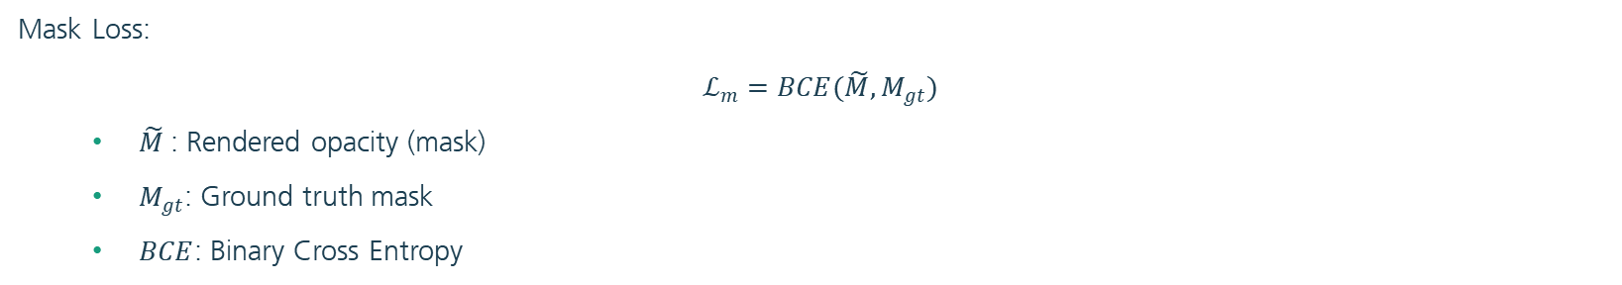
Spacetime Surfels
Optimization
We optimize the surfel parameters by minimizing the loss function $ℒ$:
$ℒ=ℒ_{p}+{λ_{o}ℒ}_{o}$ + $λ_{m}ℒ_{m}$ + $λ_{s}ℒ_{s}$
Mask Loss:
$$ℒ_{m}=BCE(\tilde{M},M_{gt})$$
$\tilde{M}$: Rendered opacity (mask)
$M_{gt}$: Ground truth mask
$BCE$: Binary Cross Entropy

Slide 16
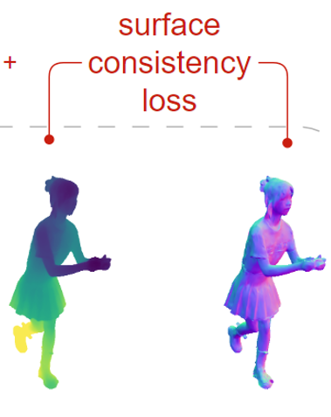
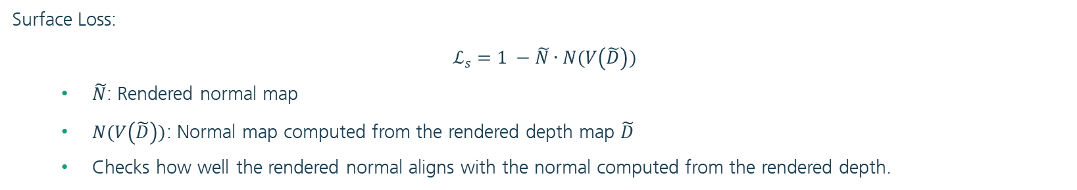
Spacetime Surfels
Optimization
We optimize the surfel parameters by minimizing the loss function $ℒ$:
$ℒ=ℒ_{p}+{λ_{o}ℒ}_{o}$ + $λ_{m}ℒ_{m}$ + $λ_{s}ℒ_{s}$
Surface Loss:
$$ℒ_{s}=1 −\tilde{N}∙N(V\left(\tilde{D}\right))$$
$\tilde{N}$: Rendered normal map
$N(V\left(\tilde{D}\right))$: Normal map computed from the rendered depth map $\tilde{D}$
Checks how well the rendered normal aligns with the normal computed from the rendered depth.
Notes:
checks how well the rendered normal aligns with the normal computed from the rendered depth. This term is crucial for maintaining geometric consistency

Slide 17
Spacetime Surfel
Training Strategy
Batch Processing:
Process 50 frames at a time
Balances memory constraints with temporal consistency
Stack-Based Sampling:
Uniform coverage: Stack contains all camera-timestamp combinations, randomly sampled and replenished when empty
Ensures balanced view sampling across all temporal frames

Slide 18
Spacetime Surfels
Pipeline Architecture

Slide 19
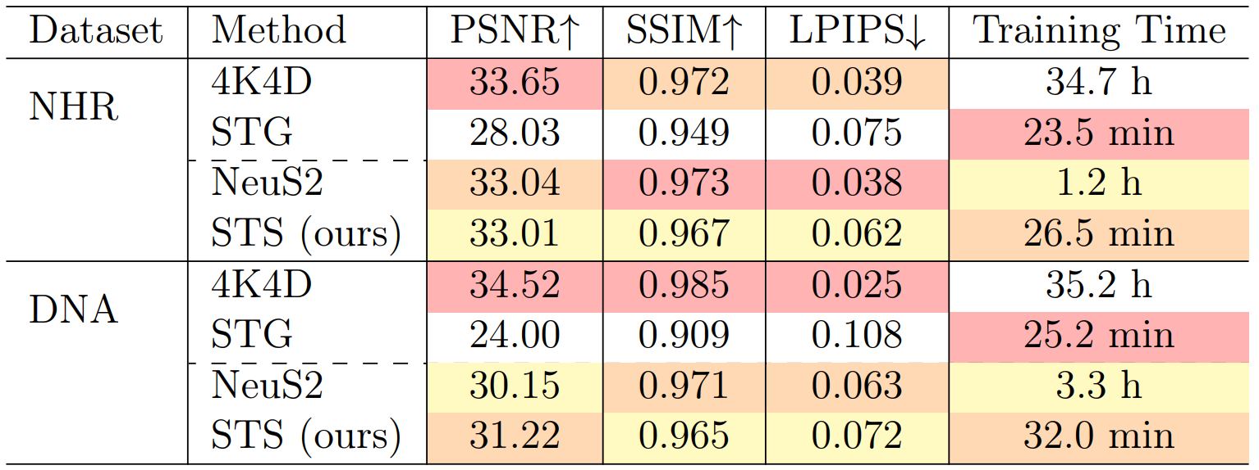
Evaluation
View-Synthesis: Quantitative Results
First best Second best Third best
Notes:
Our method has similar rendering quality to competing methods
Big advantage is the training time: which compared to it‘s main competitor NeuS2 is a lot les (1h vs 26min for NHR and 3h vs 32min for DNA)

Slide 20
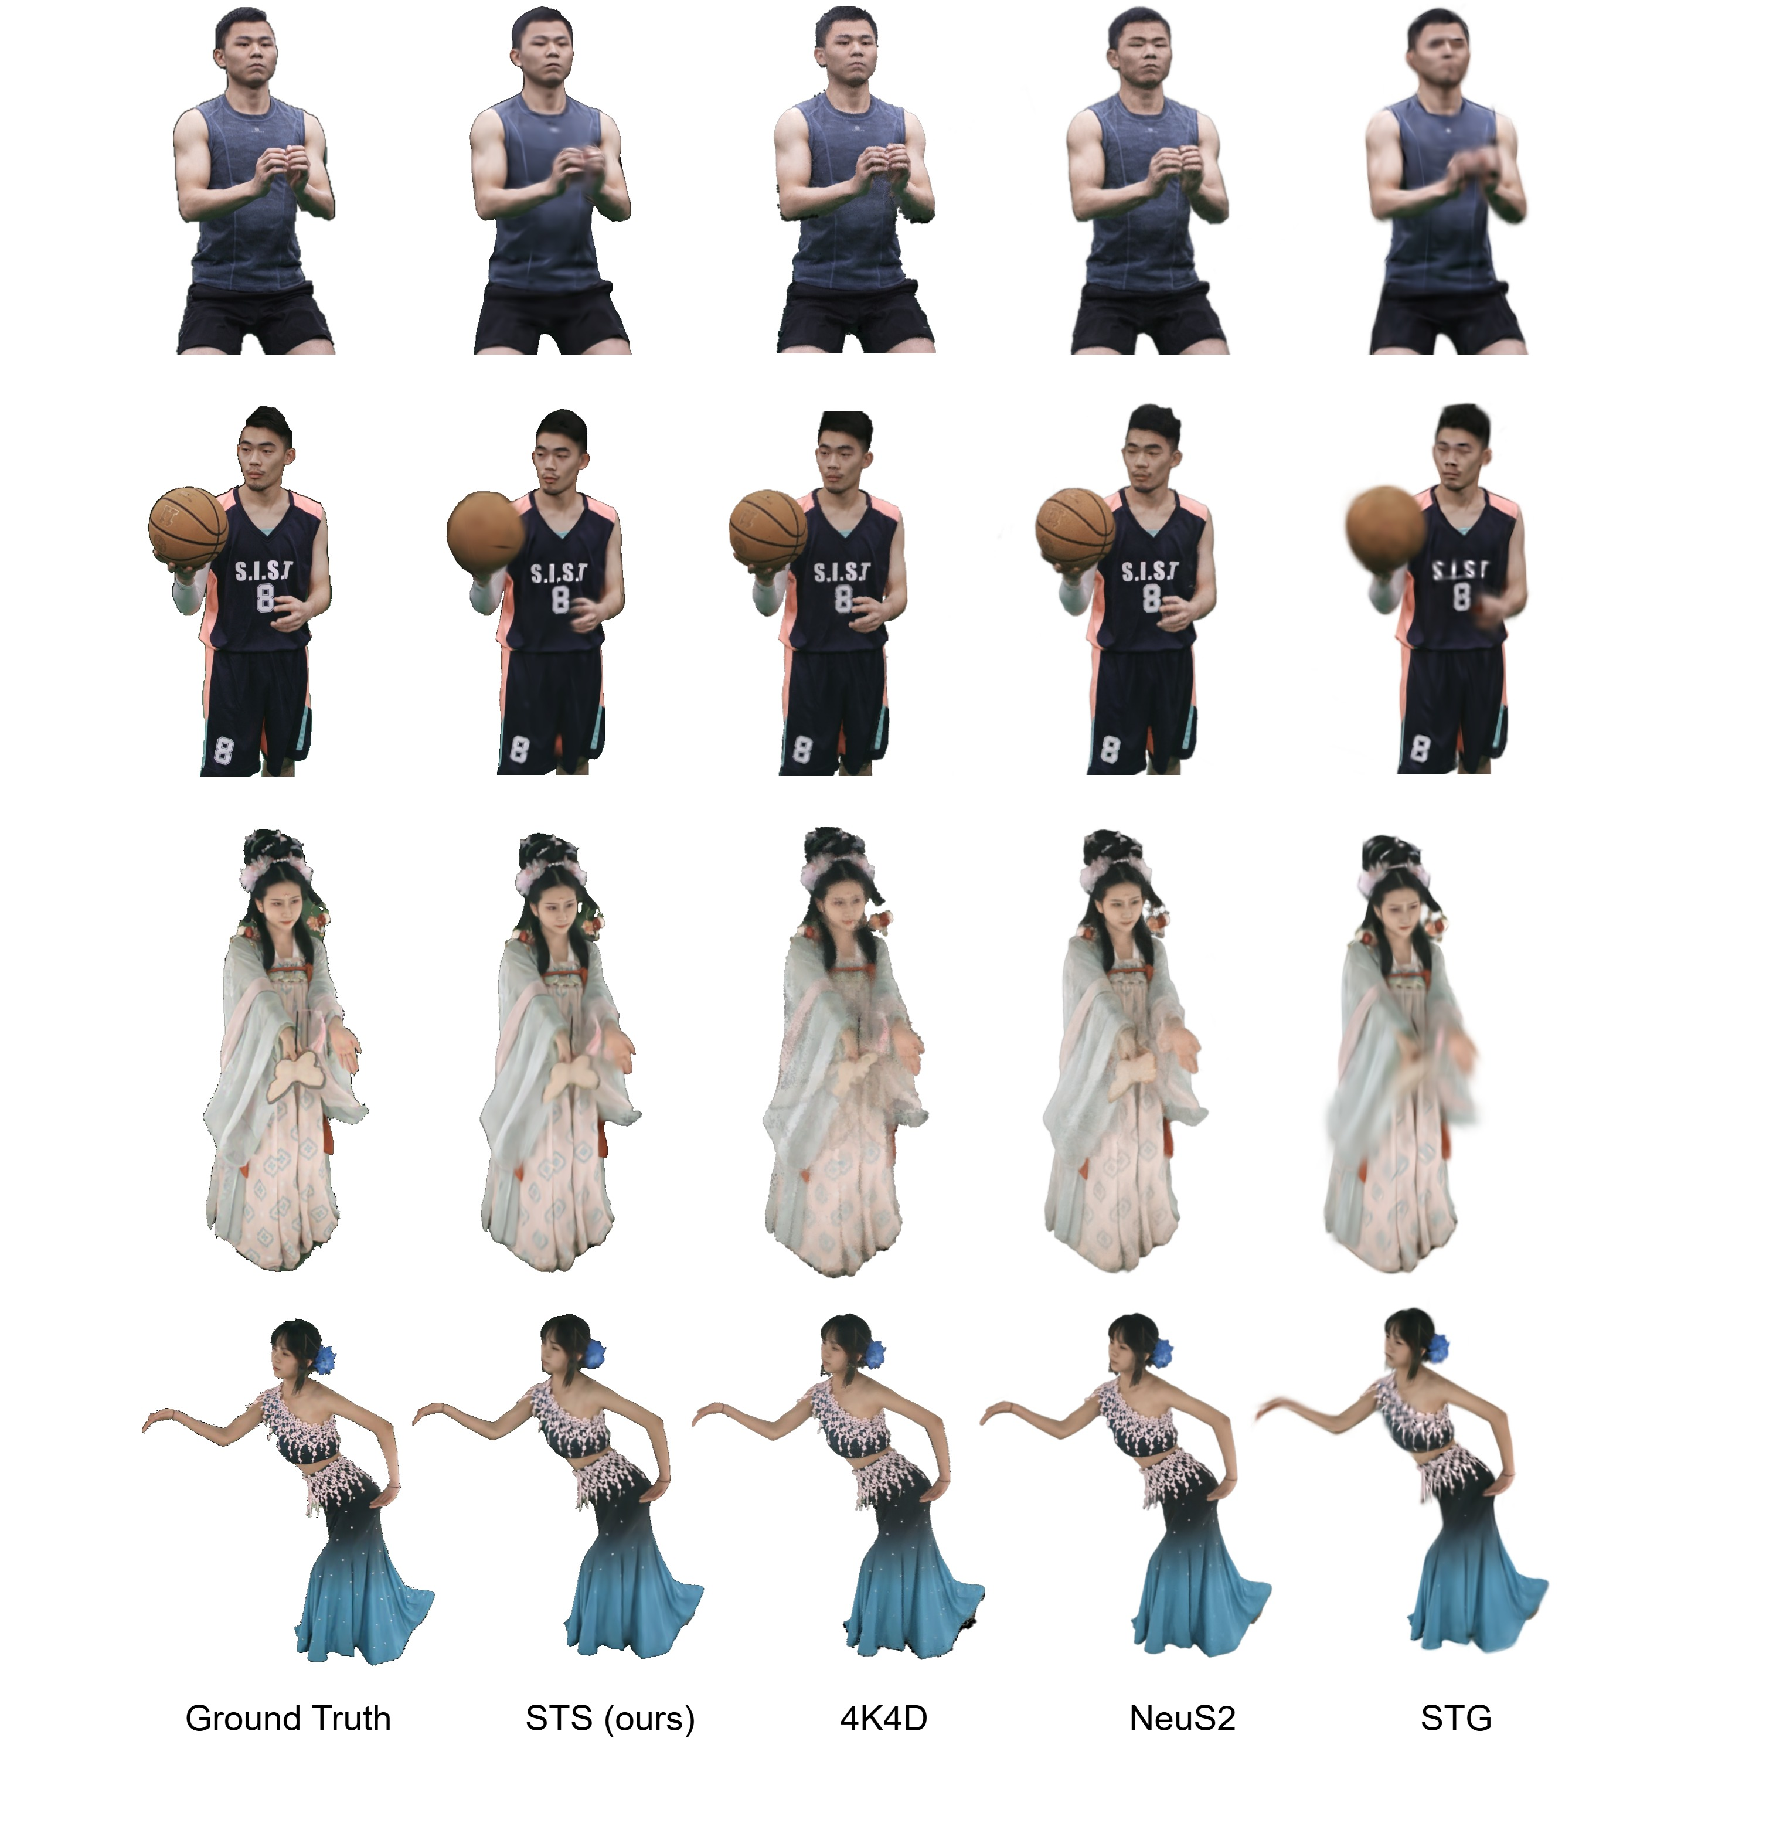
Evaluation
View-Synthesis: Qualitative Results on NHR
Ground Truth STS (ours) 4K4D NeuS2 STG
Notes:
Making the gaussian align more precisely with the surface also helps improve the rendering compared to STG
This is also visible in the basketball example,
However we see that our method doe still struggle to reconstruct fine details which move fast such as the lines on the basketball

Slide 21
Evaluation
View-Synthesis: Qualitative Results on DNA
Ground Truth STS (ours) 4K4D NeuS2 STG
Notes:
On DNA, we can see very similar or even better rendering than the competing methods

Slide 22
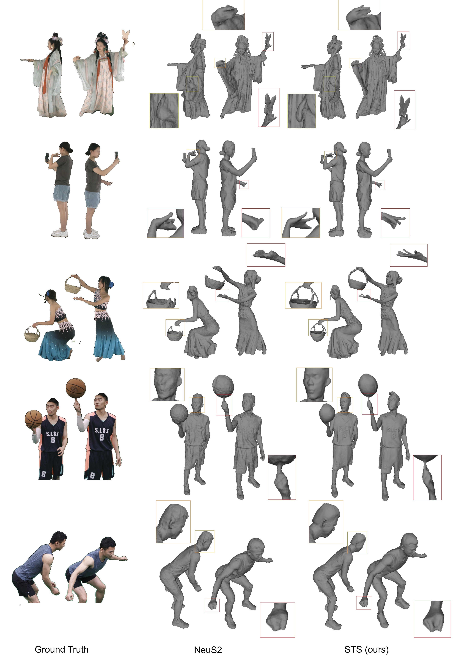
Evaluation
Surface Reconstruction: Qualitative Results on NHR
Ground Truth NeuS2 STS (ours)

Slide 23
Evaluation
Surface Reconstruction: Qualitative Results on DNA
Ground Truth NeuS2 STS (ours)

Slide 24
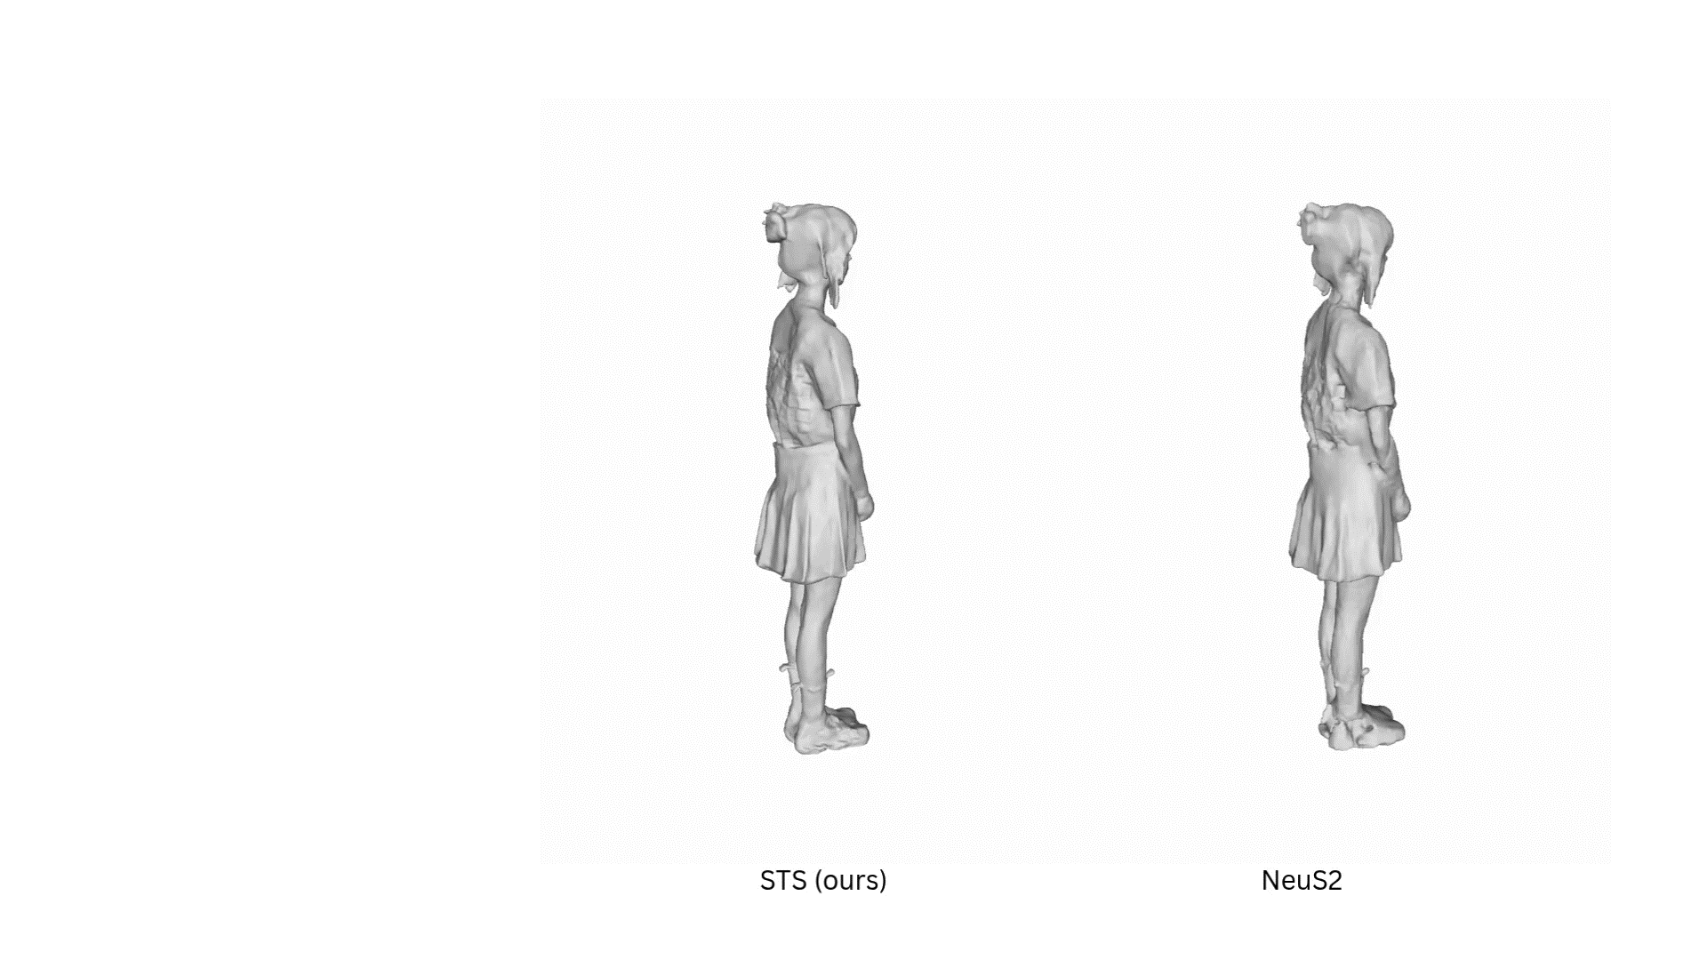
Evaluation
Dynamic Results

Slide 25
Conclusion
Achievement, Impact and Future Directions
Key Achievement:
Successfully demonstrated Gaussian Splatting's superiority over NeRF-based approaches
Established the first effective integration of dynamic view synthesis and surface reconstruction

Slide 26
Conclusion
Achievement, Impact and Future Directions
Key Achievement:
Successfully demonstrated Gaussian Splatting's superiority over NeRF-based approaches
Established the first effective integration of dynamic view synthesis and surface reconstruction
Performance Highlight:
Efficiency: ~30 minutes training vs. hours for competing methods
Quality: Superior geometric detail and temporal consistency vs. NeuS2

Slide 27
Conclusion
Achievement, Impact and Future Directions
Key Achievement:
Successfully demonstrated Gaussian Splatting's superiority over NeRF-based approaches
Established the first effective integration of dynamic view synthesis and surface reconstruction
Impact & Applications:
Enables efficient dynamic mesh reconstruction for AR/VR
Direct intergration into modern graphics engines
Foundation for future interactive 3D experiences
Performance Highlight:
Efficiency: ~30 minutes training vs. hours for competing methods
Quality: Superior geometric detail and temporal consistency vs. NeuS2

Slide 28
Conclusion
Achievement, Impact and Future Directions
Key Achievement:
Successfully demonstrated Gaussian Splatting's superiority over NeRF-based approaches
Established the first effective integration of dynamic view synthesis and surface reconstruction
Impact & Applications:
Enables efficient dynamic mesh reconstruction for AR/VR
Direct intergration into modern graphics engines
Foundation for future interactive 3D experiences
Performance Highlight:
Efficiency: ~30 minutes training vs. hours for competing methods
Quality: Superior geometric detail and temporal consistency vs. NeuS2
Future Directions:
Enhanced handling of rapid localized motion (ex: fast hand gestures, oscillating objects)
Improved temporal consistency across frame segments through intelligent parameter transfer

Slide 29
Thank you for your attention!

